Slide 1

Flight Data Analysis

Slide 2
Overview:
This dataset corresponds to the domestic flights and airports in the United States of America
CSV contains 1099444 rows and 110 columns
1099444 flights operated by 17 Airline carriers
363 Airports topographically spread across 50 states in the US along with Puerto Rico, U.S. Pacific Trust Territories and Possessions, and U.S. Virgin Islands
Flights are operated during the 4th quarter of 2021 between 1st Nov and 31st Dec
Each row is unique, and it contains the journey details of a flight - airline name, departure airport, departure city and state, scheduled departure and arrival time, actual departure and arrival time etc.

Slide 3
Agenda
Data preprocessing / Data Cleaning
Variable summaries and distributions
Checking for empty columns
Removing columns that are not used for analysis
Exploratory Analysis
Using Airlines as a metric to visualise the data
Using Airports as a metric to visualise the data
Visualising departure and arrival delays
Case studies
Exploring more about the dataset
What are the caveats?

Slide 4
Data Preprocessing/ Cleaning
Dates and Times
Year and Quarter doesn’t really prove of much value
Formatting time - departure and arrival time
Removing columns
Calculating the percentage of empty columns against a threshold of 99%
Removing columns that are not used for analysis
Addition of extra columns
Origin_airport_name and Dest_airport_name from library - airportsdata
Airline_name from Airlines.CSV
Introducing a variable Route, which defines the source and destination airport
Introducing two variables depstatus and arrstatus, which checks if the flight is on-time, early or late

Slide 5
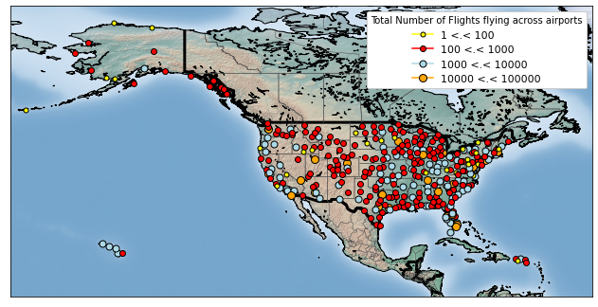
Exploratory Analysis
Topographical representation of the airports, and the frequency of flights flying to these airports

Slide 6
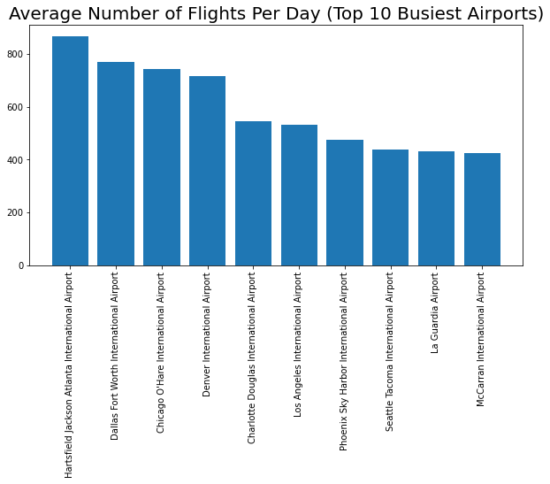
Exploratory Analysis
Airports Stats Analysis w.r.t top 10 busiest airports:
Hartsfield Jackson Atlanta International Airport is the busiest airport
52,884 flights operated during the months - Nov and Dec of 2021
~867 flights operated per day
Pago Pago International Airport is an idle airport
3 flights operated in the 2 months
~0.05 flights operated per day

Slide 7
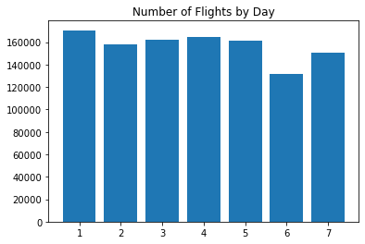
Exploratory Analysis
Distribution of flights categorized by each day of the week:
Mondays and Thursdays being the most busiest days of each week, with 170,567 and 164,793 flights operated respectively
Saturdays being the least busy, with 131,840 flights operated

Slide 8
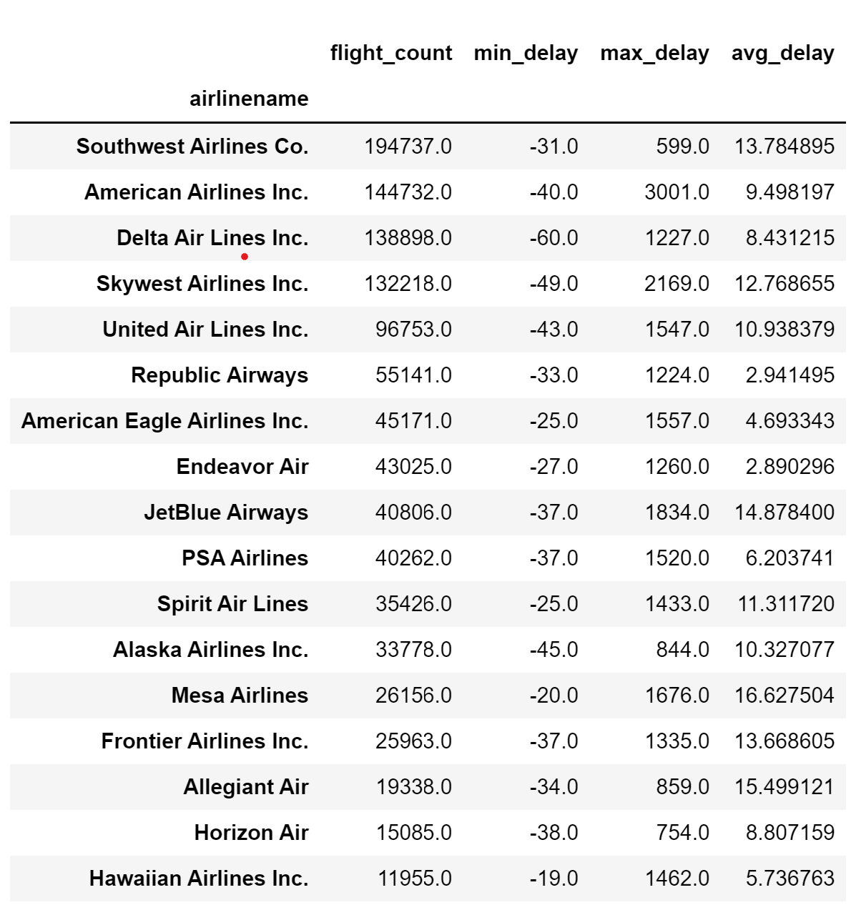
Exploratory Analysis
Airline Stats Analysis:
Southwest Airlines Co. operated about 194,737 flights during the last 2 months, amounting to 17.7% of the total number of flights
Hawaiian Airlines Inc. operated about 11,955 flights during the last 2 months, amounting to 1.1% of the total number of flights

Slide 9
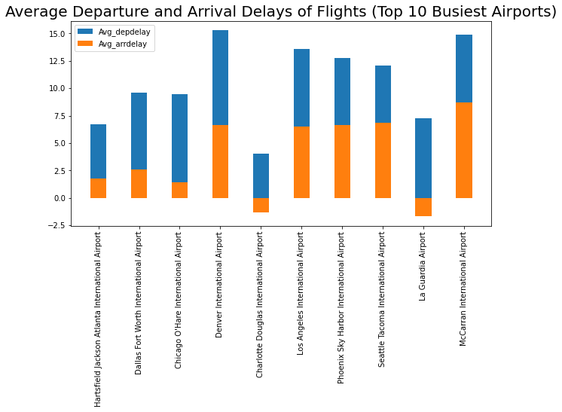
Exploratory Analysis
Departure Delay Analysis w.r.t top 10 busiest Airports:
Denver International Airport has the highest average departure delay (~15.3min per flight)
Charlotte Douglas International Airport has the lowest average departure delay (~4.1min per flight)
Arrival Delay Analysis w.r.t top 10 busiest Airports:
McCarran International Airport has the highest average arrival delay (~8.7min per flight)
La Guardia Airport has the lowest arrival delay (~-1.7min per flight)

Slide 10
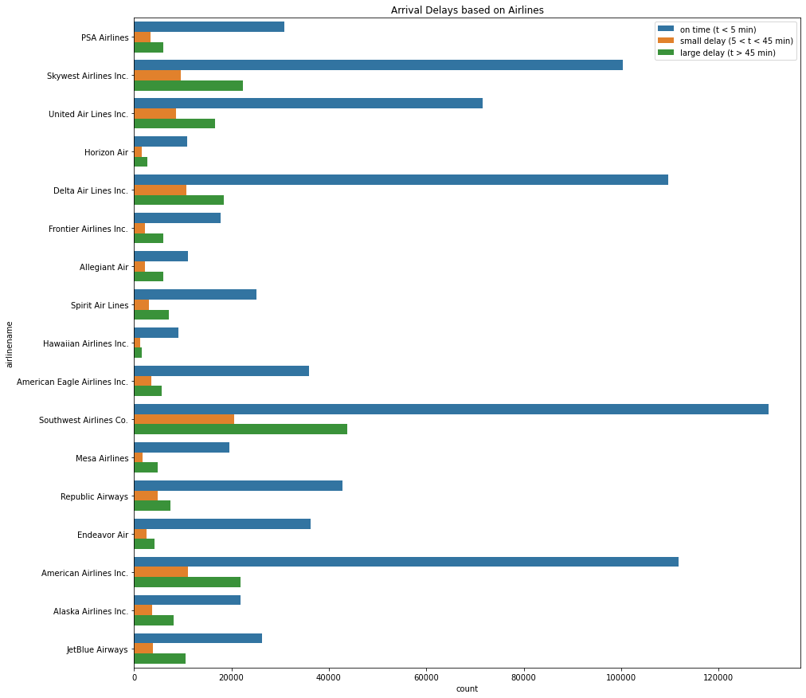
Exploratory Analysis
Arrival Delays w.r.t Airlines:
The arrival_status is classified as on_time, small_delay, and large_delay
Southwest Airlines Co. has the highest arrivals on-time (about 125,569 flights, ~64% of the total flights)
Southwest Airlines Co. also has the highest number of flights with a large arrival delay (about 43,843 flights, ~23% of total flights)

Slide 11
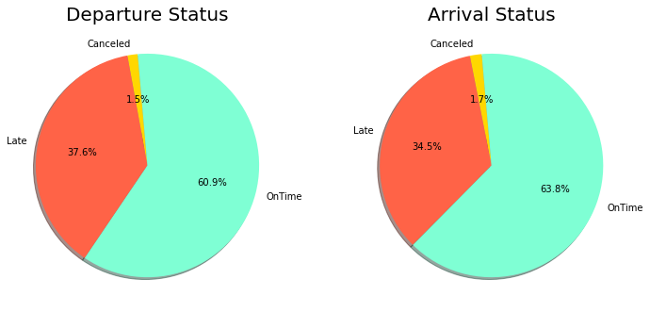
Exploratory Analysis
Flight status distribution - departure and arrival
Out of 1099444 flights, 669561(60.9%) flights departed on time, 413390(37.6%) were delayed and 16492(1.5%) of flights were cancelled.
Out of 1099444 flights, 701445(63.8%) flights arrived on time, 379308(34.5%) were delayed and 18690(1.7%) of flights were cancelled.

Slide 12
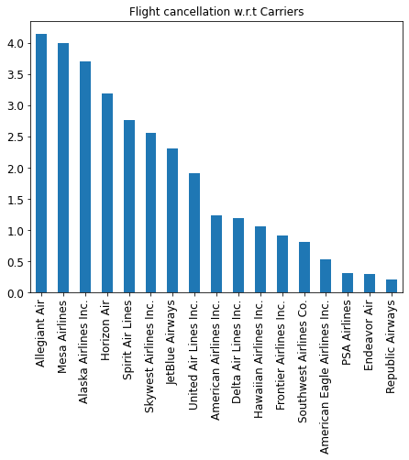
Exploratory Analysis
Flight Cancellation analysis w.r.t Airlines:
Allegiant Air has cancelled about 802 flights, making it the airline with the highest percentage of cancelled flights.
Whereas, Republic Airways has cancelled about 115 flights, making it the airline with the least percentage of cancelled flights.

Slide 13
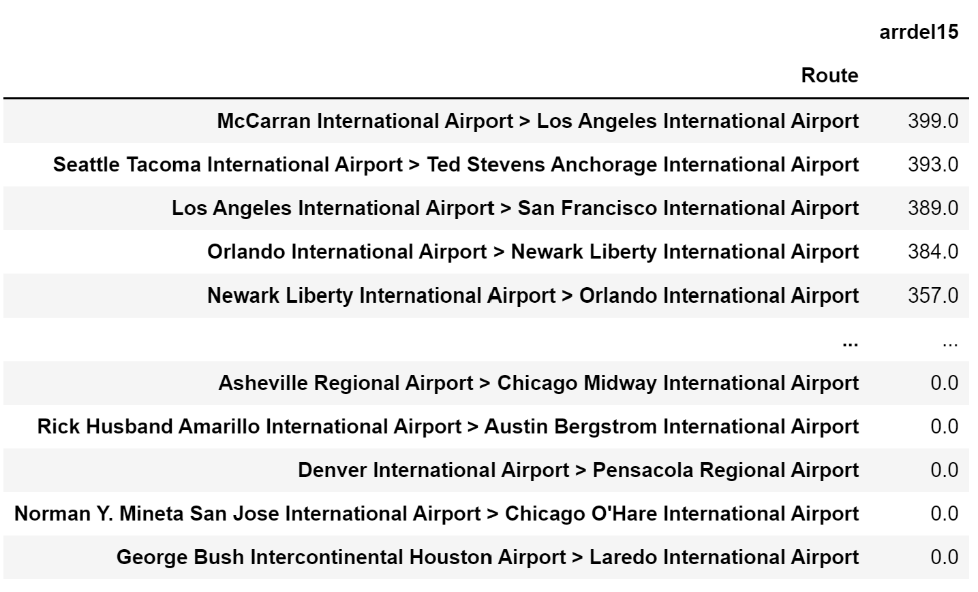
Exploratory Analysis
Route Analysis (1):
Analysing the routes which have a large arrival delay (arrival delay of more than 15 min):
McCarran International Airport > Los Angeles International Airport, has the largest number of arrival delays

Slide 14
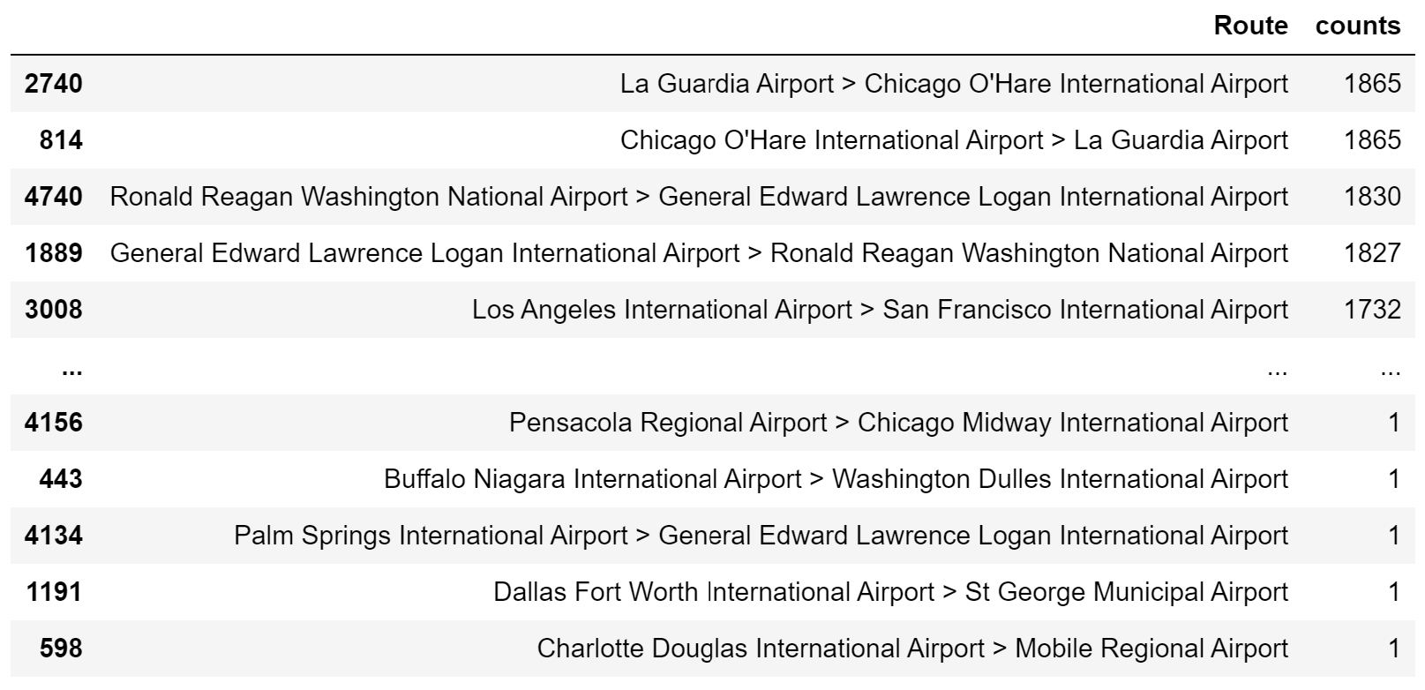
Exploratory Analysis
Route Analysis (2):
Analysing the frequently used routes-
La Guardia Airport > Chicago O’Hare International Airport and the return flight are the most frequent flying route

Slide 15
Case Studies:
Mesa Airlines:
This airline has recorded the highest average departure delay (~16 mins per flight)
On analyzing the top 3 airports, Mesa Airlines has departed from:
Dallas Fort worth International Airport (avg depdelay: 9.6 mins per flight)
Phoenix Sky Harbor International Airport (avg depdelay: 12.7 mins per flight)
George Bush Intercontinental Houston Airport (avg depdelay: 11.1 mins per flight)
By ranking the busiest airports, all three airports mentioned above fall in the top 15 busiest airports
This could have been the reason for the large departure delay Mesa Airlines faces

Slide 16
Case Studies
2. Pago Pago International Airport:
There are 363 unique airports in this dataset
On visualisation, Pago Pago International Airport has the highest mean departure and arrival delay (~390 mins)
On further analysis, only 3 flights have departed from Pago Pago Airport. One of them suffered a delay of 1037 mins.
Additionally, every flight that departed from Pago Pago Airport suffered a departure delay of atleast 50 mins.
This explains the incredibly high mean departure delay recorded at this airport.

Slide 17
Caveats of this dataset
The content of CRSDEPTIME (Scheduled departure time) and CRSARRTIME (scheduled arrival time) variables can be a bit misleading since they don't contain the dates. For example, in row 97229 of the dataframe, the scheduled departure is at 23h32 on 27nd, December. But due to unknown reasons there is a delay of 29 minutes. The DEPTIME (actual departure time) variable indicates 00h11.
DivAirportLandings has values - 0,1,2,9. Each value represents the number of airports diverted to. There are a few rows with value 9, but there seems to by only one diverted airport recorded in the dataset.
There are some flights which have been cancelled. However, the departure time has been recorded. But there is no data recorded for arrival or diversion.
It’s difficult to analyse reason for delays - carrierdelay, weatherdelay, nasdelay, securitydelay, lateaircraftdelay. Even though the delayed minutes have been recorded, it’s hard to tell if the delay has occurred at the departure airport or arrival airport.

Slide 18
Further Insights (Future Work):
With the help of the distancegroup column, it is possible to find out long-haul and short-haul flights
Analysis on diverted flights
Flight cancellation analysis - with the cancellation code, it is possible to get some insight on the reason for cancellation
TimeBlock column can be used as a parameter to determine the busiest airports.
A correlation matrix can help us determine the dependent features
Flight delay prediction model can be developed

Slide 19
Thank you

